Slide 1

CIM Student Employment
CIM Student Training for TimesheetX

Slide 2

Student Employment - TimesheetX
TimesheetX = Total Solution
TimesheetX helps schools automate the time sheet submission and approval process for students, employers, and administrators.

Slide 3
Student Employment - TimesheetX
Benefits for Students:
  Automated notices
  Award balance display
  Never a lost time sheet
  Web accessibility
  Eliminated paper forms
  Full work history
  Deadline reminders

Slide 4
You’re Hired!
Now what do you do?

Slide 5
Enter a Timesheet!

Slide 6
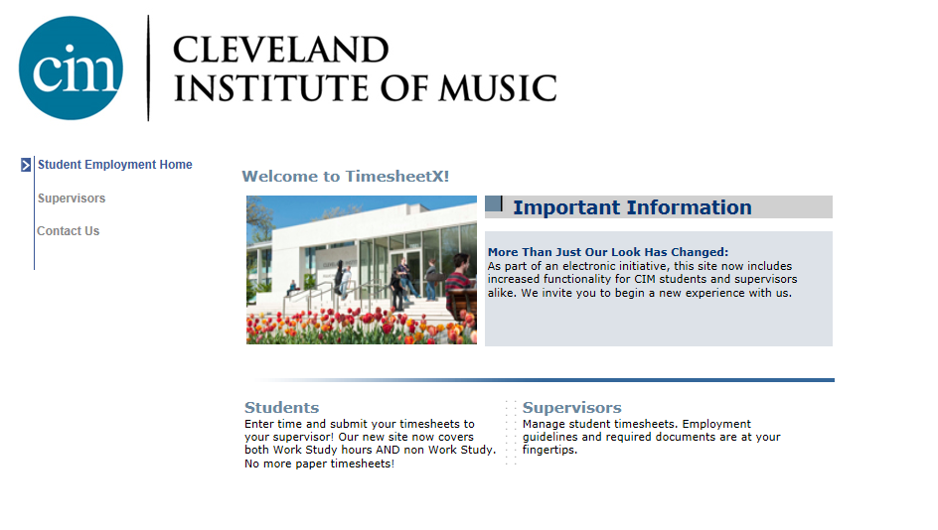
Navigate to the following URL:
https://cim.studentemployment.ngwebsolutions.com/Cmx_Content.aspx?cpId=6
Please click the ‘Students’ link displayed on the main screen.

Slide 7
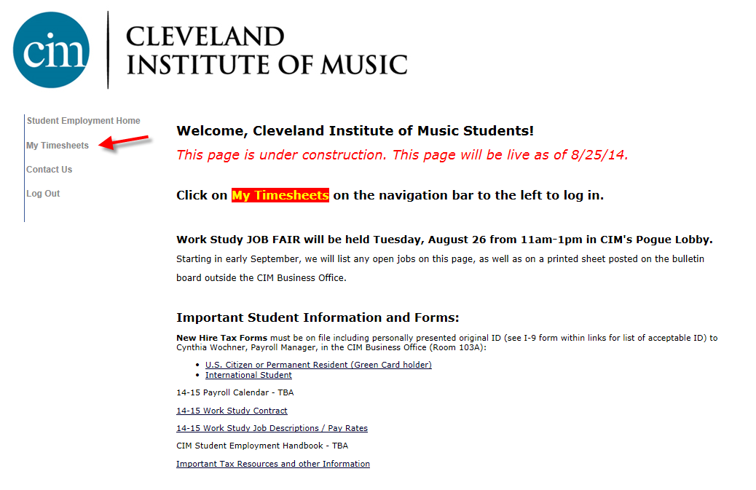
This page has forms and helpful information. Click on My Timesheets.

Slide 8
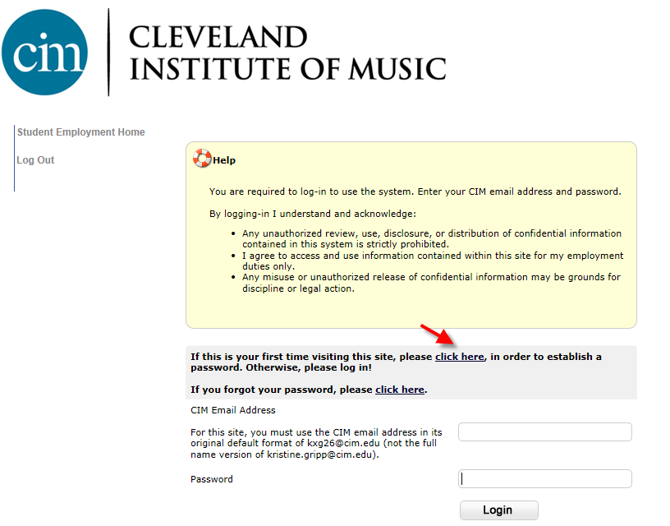
If this is the first time to this site, click on the link shown above to establish a password, otherwise, enter your email address and previously established password.

Slide 9
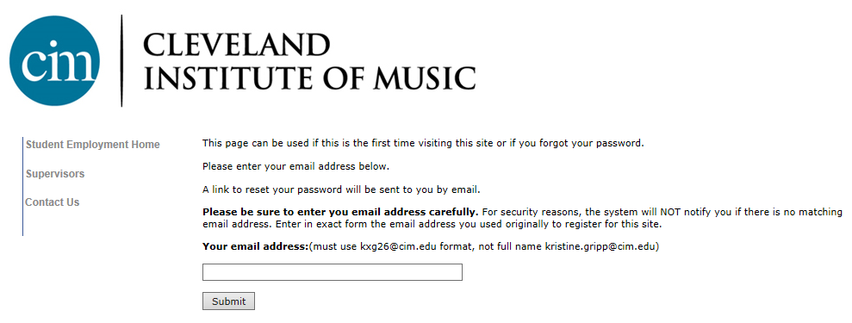
Follow the instructions listed on this page. When you receive the email, click on the link provided in the email. You will be taken to a screen that will allow you to enter and confirm a password.

Slide 10
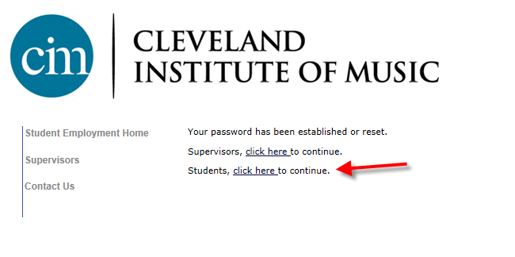
Once you have established a password, you will be logged into the site. On the screen above, click on the Students link.

Slide 11
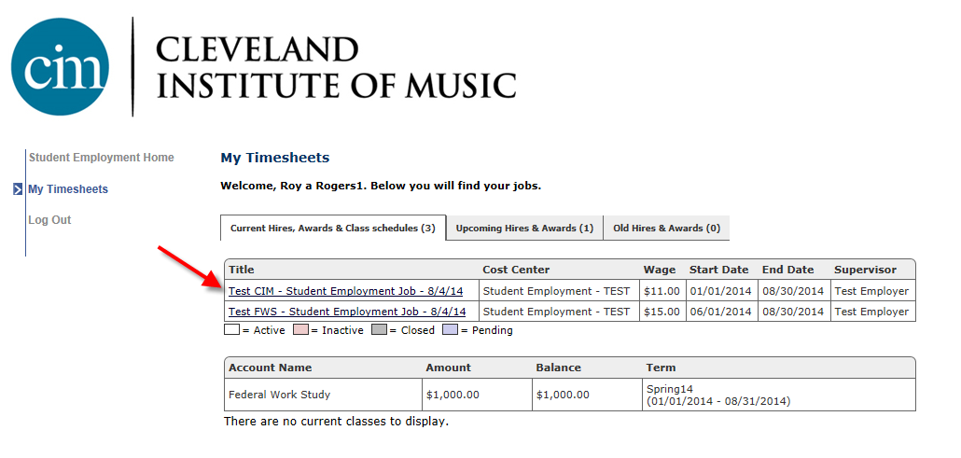
This is where you view your hires, awards and view/update your timesheets.
Click the specific job title to view/update your timesheets.

Slide 12
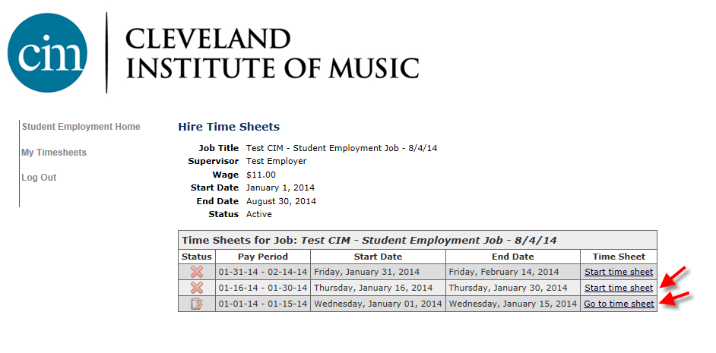
If this is the first time you are entering a timesheet for the current pay period, click ‘Start Timesheet’.
If you have already entered time for the current pay period, the link will be labeled ‘Go to Timesheet’.

Slide 13
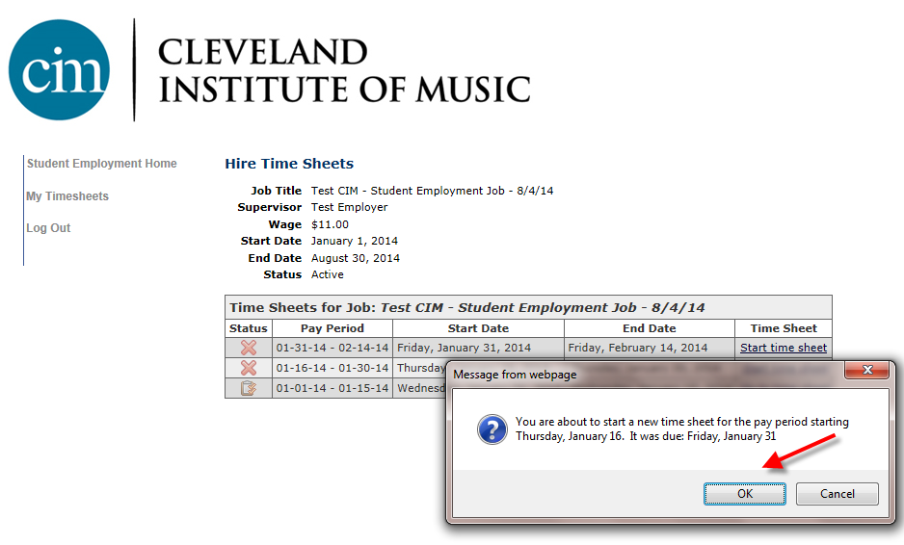
When starting a new time sheet, please click ‘OK’ on the confirmation dialog box presented.

Slide 14
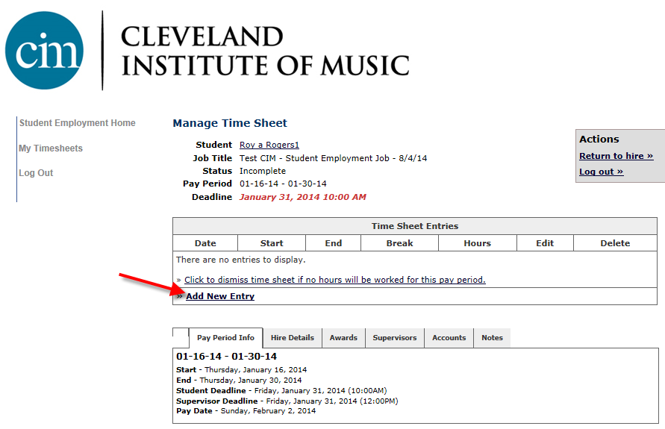
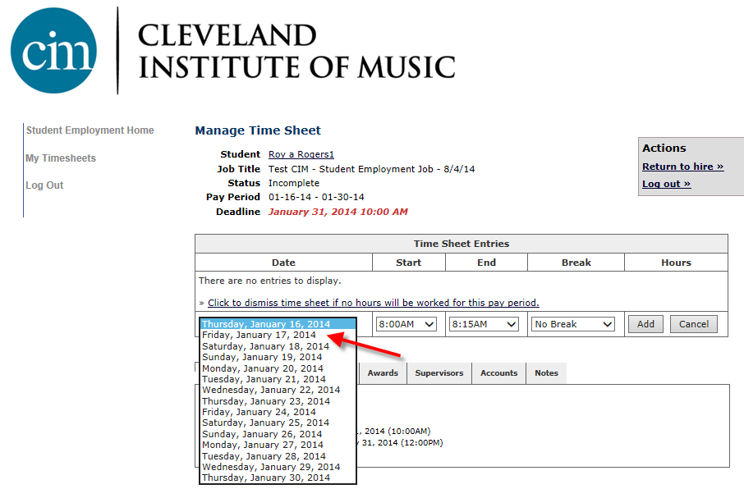
Click on the “Add New Entry” link.
Select the date for the day you are entering time.

Slide 15
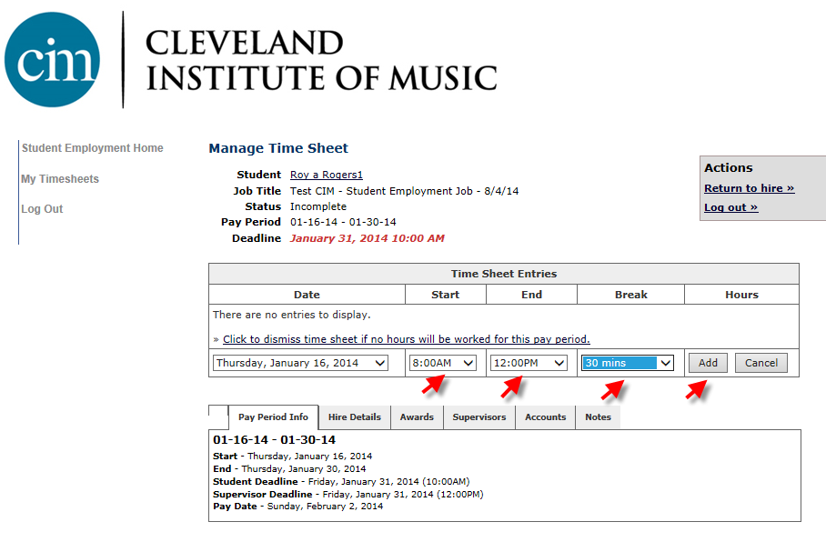
Select the start and end time for the day you are entering time and any applicable break hours.
Click on the “Add” button to save the start and end times entered.

Slide 16
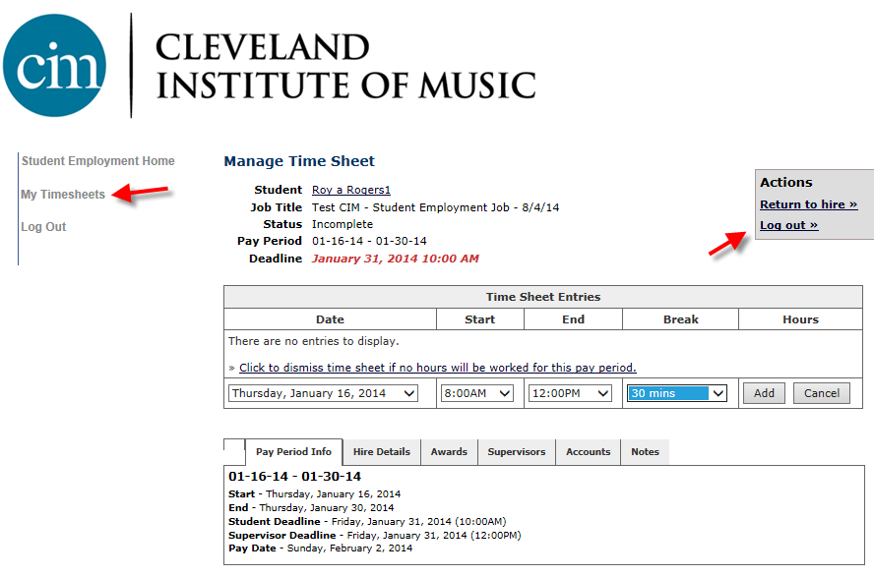
If you are finished entering time for this job and wish to enter time for a different job, click ‘My Timesheets’ to return to your list of jobs.
If you wish to log out, click the ‘Log out’ button and you will return to the Student Employment Home.
Note: You may not work work more than 20 hours per any Monday- Sunday workweek, all jobs combined, during the academic year.

Slide 17
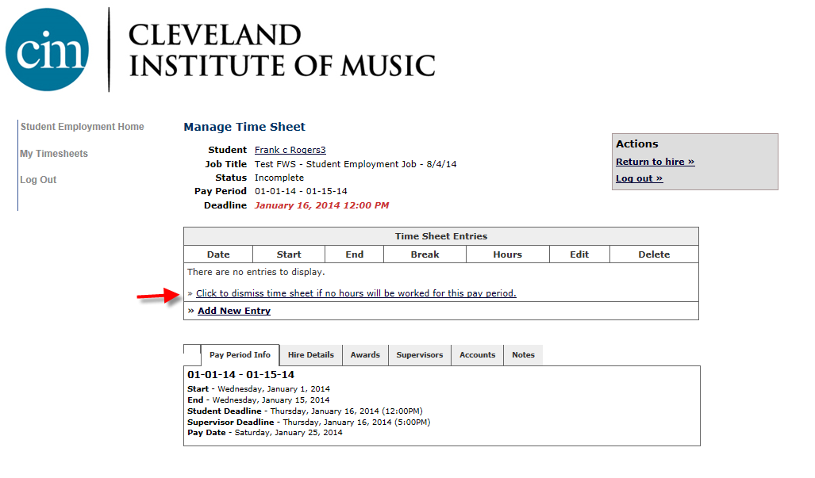
If you know that you didn’t work any hours during a specific pay period, click the link shown above to ‘Dismiss’ your timesheet.
This is a required step every time you have no hours for a job in a pay period, otherwise we will assume you have a delinquent/past due time sheet yet to submit. If you are no longer working in a job, let us know and we will make it inactive.

Slide 18
Done Entering Time?
Hand In your Timesheet!

Slide 19
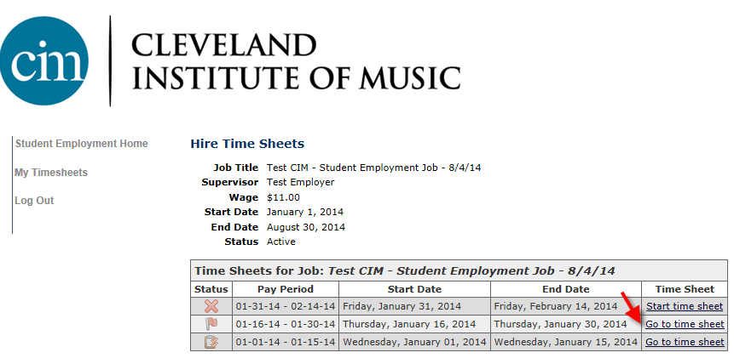
Click ‘My Timesheets” link on the left NavBar.
Click on the Job Title of the job you wish to submit your time.
Click the “Go to time sheet” link to review and turn in your time.

Slide 20
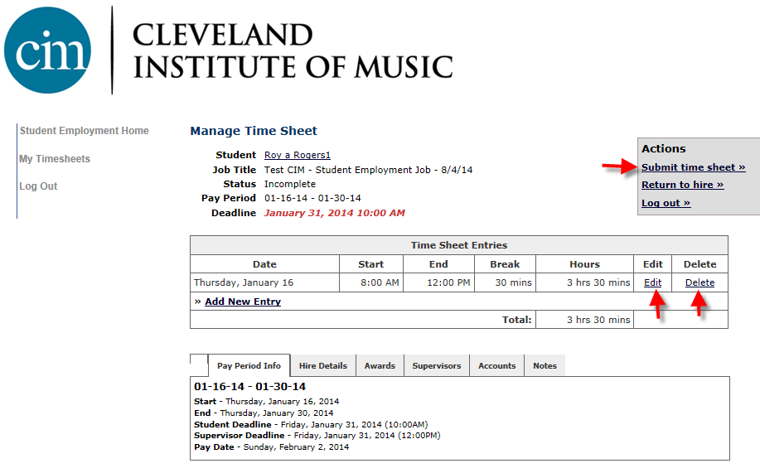
1. If your timesheet entries look correct, click ‘Submit Time Sheet’.
2. If you need to update the start or end date on a timesheet entry, click ‘Edit’.
3. If you want to delete the timesheet entry, click ‘Delete’.

Slide 21
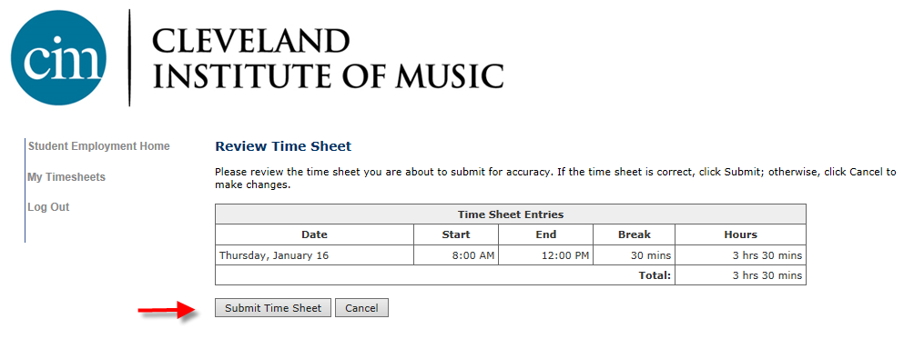
Click ‘Submit Time Sheet’

Slide 22
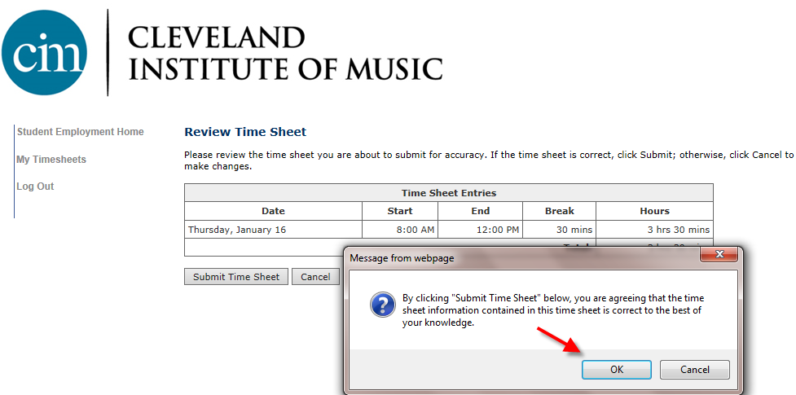
Click ‘OK’ to confirm and your time sheet is now pending approval by a
supervisor.
Please Note: You cannot access it again unless your supervisor
Rejects it.

Slide 23

CONGRATULATIONS!
Your Timesheet has been successfully submitted to your Supervisor for review/approval.

Slide 24
Misc. Info and FAQ’s:
Students with at least one active job will receive an automatic email reminder each pay period 48 hours in advance of the time sheet due date. If a timesheet is submitted late, it will be paid on the next applicable pay date. Repeated failure to submit time sheets in a timely manner may result in termination from the Work Study (WS) program.
Students will see an alert once they are within $200 of earning their Work Study award for the year. Remember, the award amounts are set up for WS as the fall/spring combined value, not for one semester. The only time an award would be posted for one semester is if the student is expected to be enrolled for only one semester, not two.
Students may not work in excess of 20 hours per week (Monday-Sunday timeframe) at any point during the enrolled academic year, all jobs combined. If you attempt to submit hours that exceed that limit (all jobs combined), you will see an error message. You must contact the Financial Aid Office if this occurs.
Every pay period, you must log in to either enter your worked time or “dismiss” a timesheet for each job. If you did not work at all for any job, you must formally indicate you have no hours by “dismissing” the timesheet. Otherwise, it will appear to us you are delinquent in submitting your timesheet. Let us know if you permanently stop working for a specific job and we can make it inactive.
If you see a mistake in your timesheet once you have submitted it, you must contact your supervisor to make a correction for you.
Be sure to review and comply with all aspects of the Student Employment Handbook, also linked on the main student page here on TimesheetX.
Any questions, please contact Kristie Gripp or Lindsey Sobeck in the Financial Aid Office via the “Contact Us” form on the left NavBar within TimesheetX. For Non Work Study questions, contact Cynthia Wochner, Payroll Manager, via that “Contact Us” option.

